Slide 1
Laser House
Issue 16
August 2021
Dear Resident,
Welcome to the sixteenth edition of our Newsletter for the Laser House project.
What We Have Done So Far
Completion of brickwork to the art box extension
Commencement of smoke tests to floors – testing the plenum
Hoist removal
Skylight installation to level 3 terrace
Tiling in toilets
What’s Next?
Lift Install to core 1 and core 2
Windows installation to art box
Skylight installation to level 1 terrace
Continuation of painting and decorating
Door installation and ironmongery
Main Upcoming Deliveries
Mobile Crane 31st August to install skylight to level 1 terrace (road closed)
Sliding Shutters to be delivered which will be installed to pear tree street loading bays
Screed lorry 20th and 21st August
Mobile Crane 31st August 2021
Pear Tree Street will be partially closed on the 31st of August for through traffic subject to weather conditions. Pedestrian access to residential buildings will be maintained. The crane will be positioned as per previous arrangements.
We will be lifting the skylight for the level 1 terrace.
Our Carbon Footprint
On the Laser House Project, the architect has taken an environmental and sustainable approach to the design and buildability of the project. However, as the main contractor, reducing our carbon footprint has been a significant facet from project start to project completion. Some of are sustainable initiatives are:
Timber Recycling – so far we have recycled 100 tonnes of timber.
Tracking our carbon emissions from deliveries
Carbon offsetting at the end of the project
Involvement in ‘help your park’ litter pick day for Islington council
Recycling water cooler bottles
Hoarding Lights on a timer

Slide 2
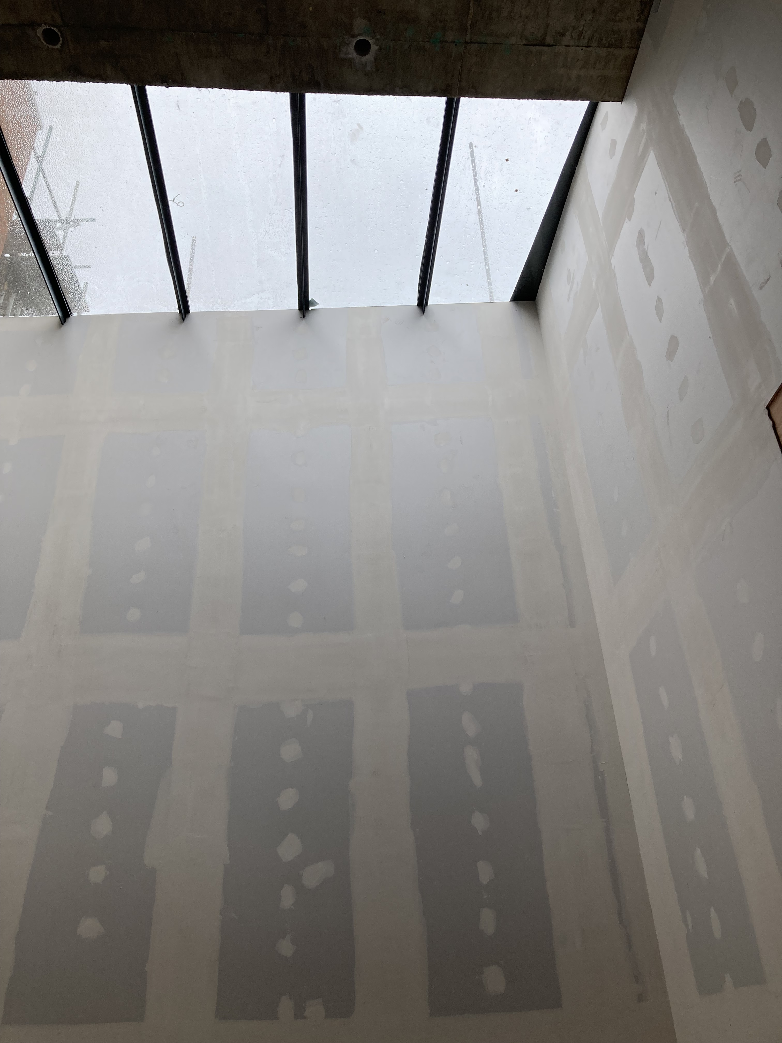
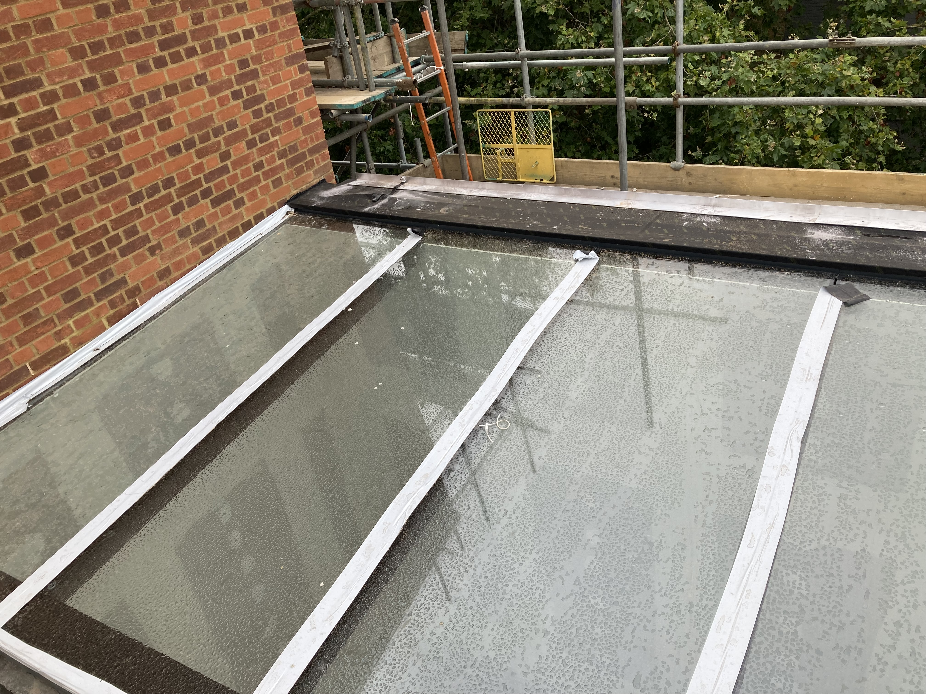
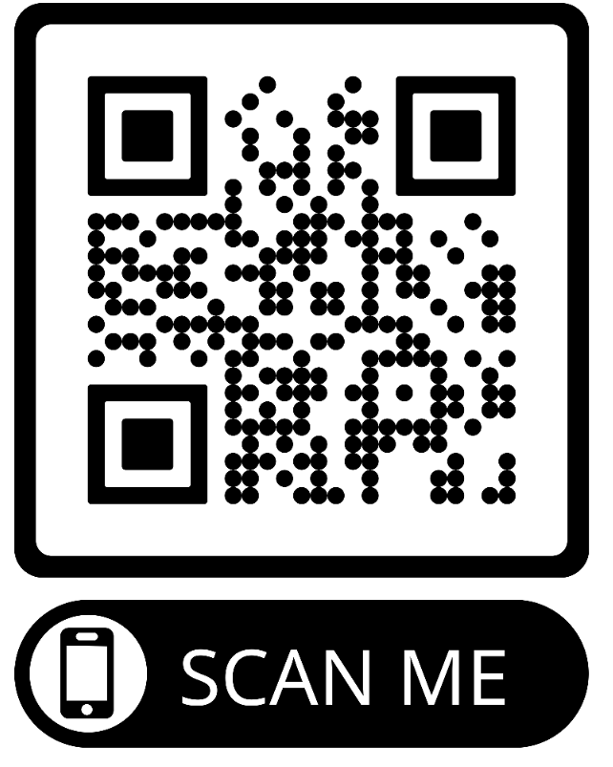
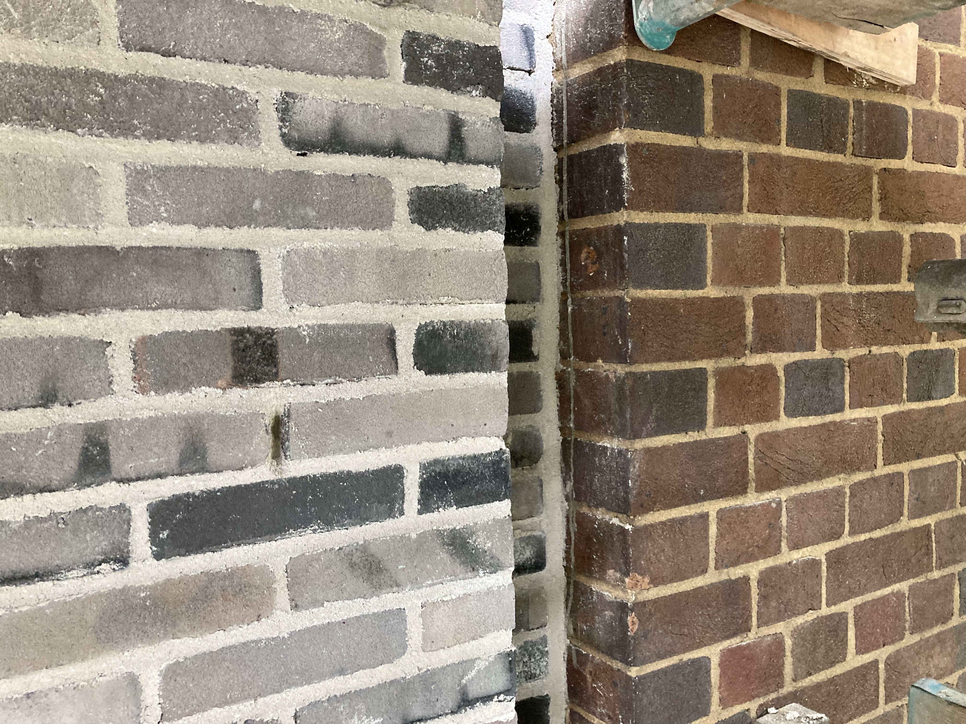
Here To Help
As always, if you have any queries or concerns, or if you would like any further information, please do not hesitate to contact us via the details below or by post:
GRAHAM Site Office
132 – 140 Goswell Road,
London,
EC1V 7DY
Project Page
Scan this barcode to visit our project page, where you can find more information and photos.
Peter McNeill
Jamie Tombs
Peter McNeill
Project Manager
Site Manager
T:
07384527571
T:
07881340755
E:
Jamie.tombs@graham.co.uk
E:
Peter.McNeill@graham.co.uk

