Slide 1
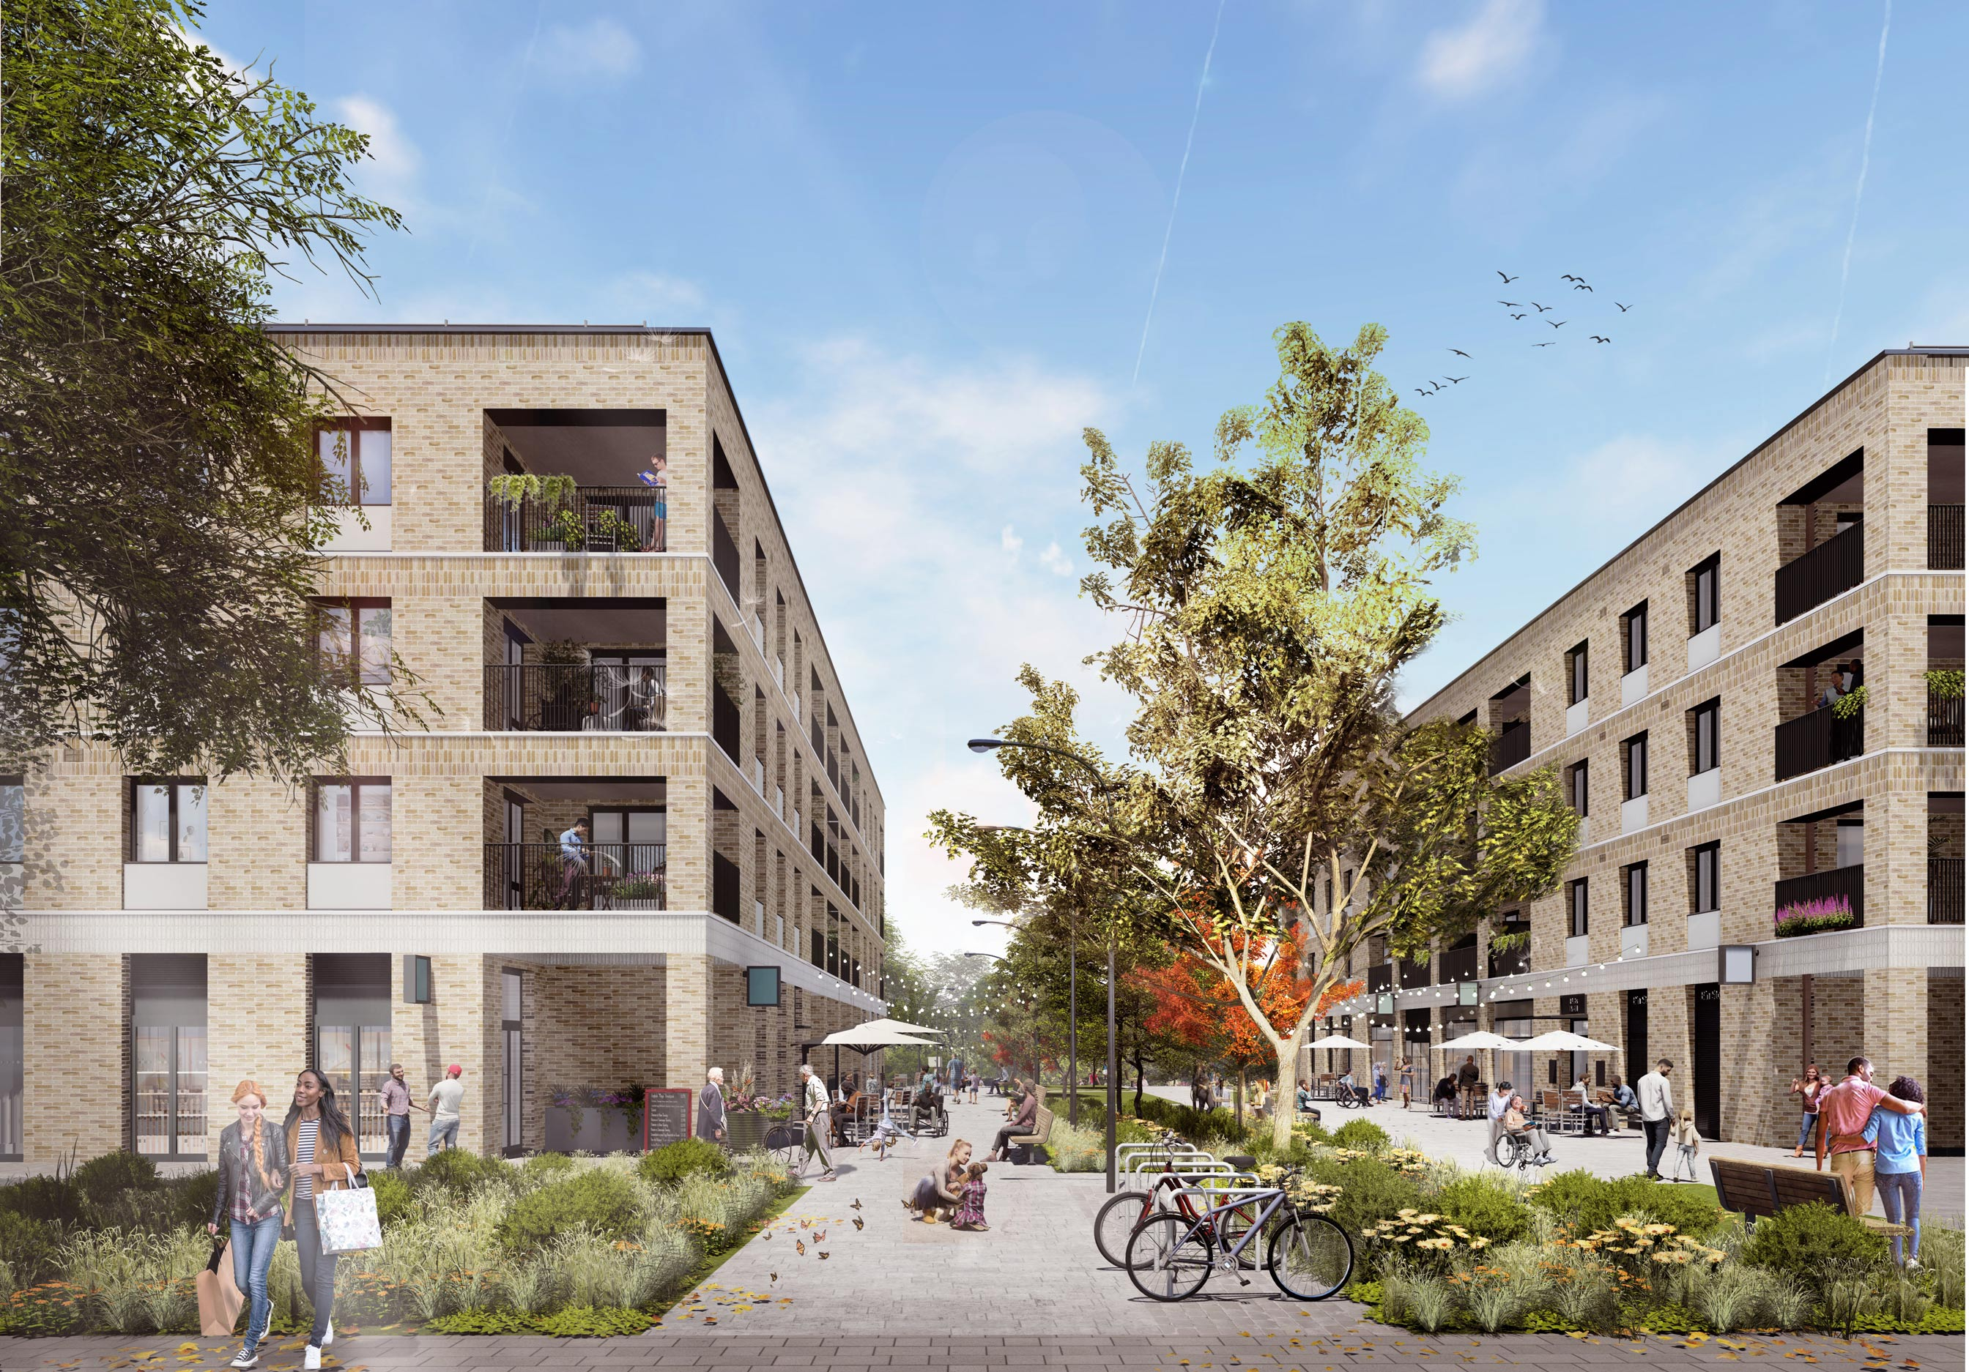


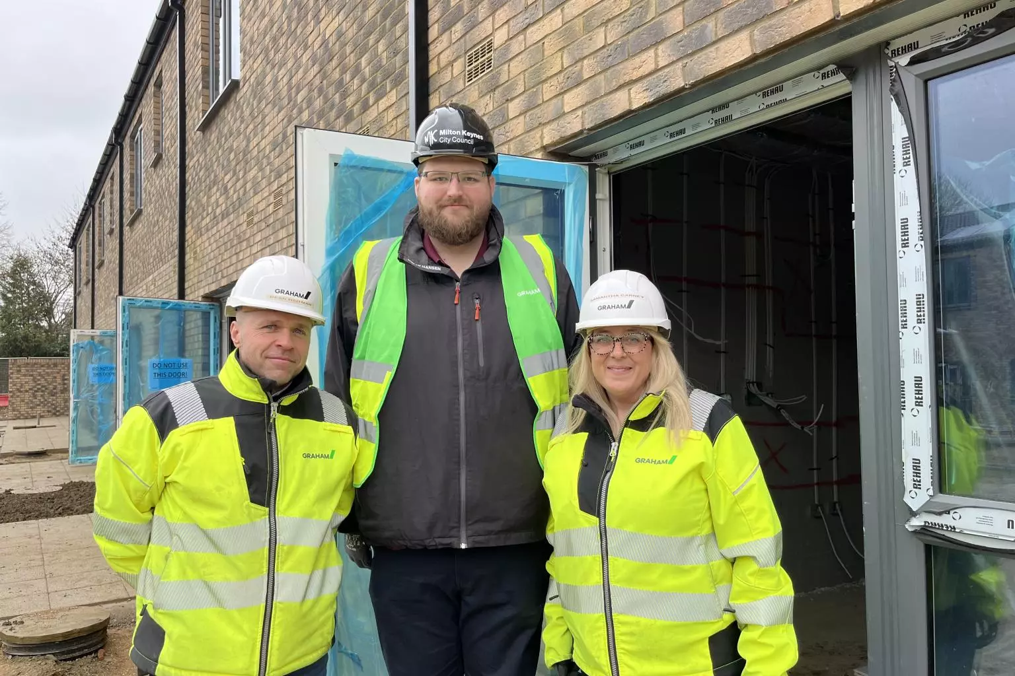
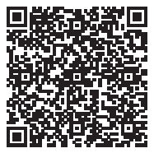
Lakes Estate Renewal Project
Construction Phase Newsletter
Issue 13 | February 2025
Welcome to the 13th edition of our monthly newsletter, keeping you up to date with the developments on the Lakes Estate Renewal Project.
BUSINESS COACHING & MENTORING
Our next mentoring session is Wednesday 9th April at 1pm, again delivered via Microsoft Teams, with the theme of ‘Green Skills / Carbon Reduction’.
The workshop is for small businesses and will review current legislation, look at best practice, and advise and support the companies with becoming more energy/cost efficient and improve their green credentials.
This will be delivered by a member of the GRAHAM Environment and Sustainability Team who has an Energy Efficiency and Auditing background.
If you would like to be involved, please email localopps@graham.co.uk or call 07385 404817 for sign up details.
CABINET MEMBER FOR HOUSING SITE VISIT
As we reach the milestone of all new houses having roof tiles in place and being watertight, we were delighted to welcome Cabinet Member for Housing, Cllr Ed Hume, for a site visit.
“It was brilliant to visit the Lakes Estate and see the project coming to life. These new homes will make a real difference, providing families with high-quality housing which will help them in so many ways. We’re not too far away from the first homes being ready and I’m sure the new tenants will be delighted. The Lakes Estate has a brilliant community, and I’m incredibly proud of how they’ve worked with us to shape this regeneration.”
COMMUNITY AND LASTING IMPACT INNOVATION FUND
We are currently in the process of reviewing applications. All are being carefully considered and assessed by a panel. A decision will be made soon, and we will update all applicants in due course.
- Cabinet Member for Housing, Cllr Ed Hume
RESIDENT FEEDBACK SURVEY
Our feedback survey deadline has been extended to end March 2025. If you would like to complete a survey you can either collect a paper copy from Spotlight or scan the QR code.
LAKES ESTATE RENEWAL FORUM MEETING
The next Lakes Estate Renewal Forum (LERF) meeting will take place on Thursday 1st May from 6:30pm at Spotlight, 114 Serpentine Court, Lakes Estate, Bletchley, MK2 3QR.

Slide 2
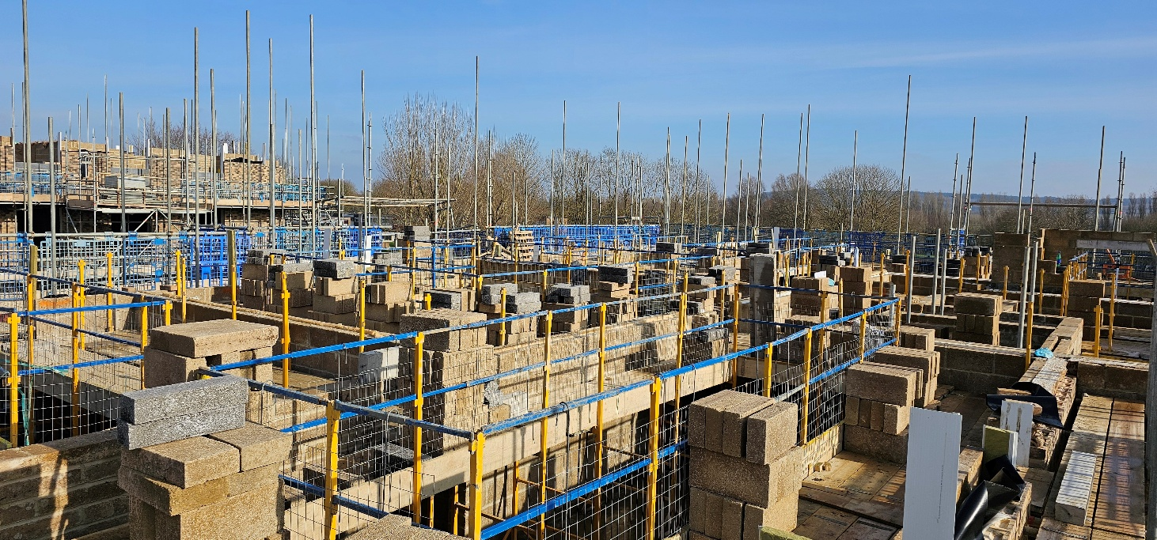
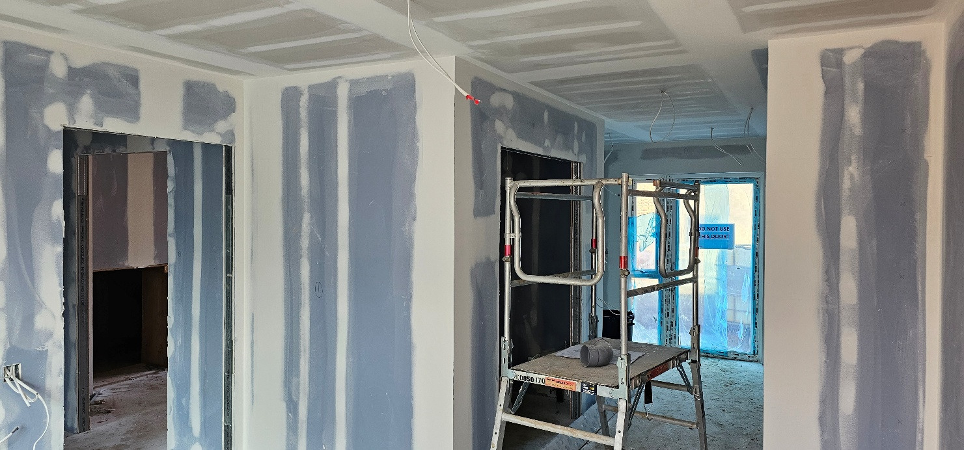
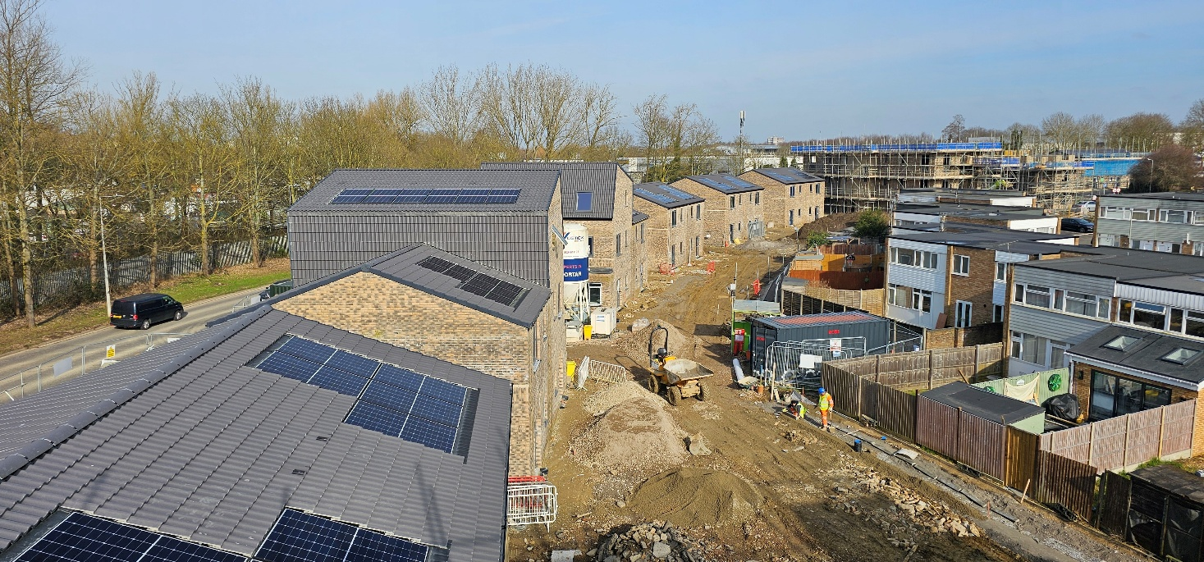
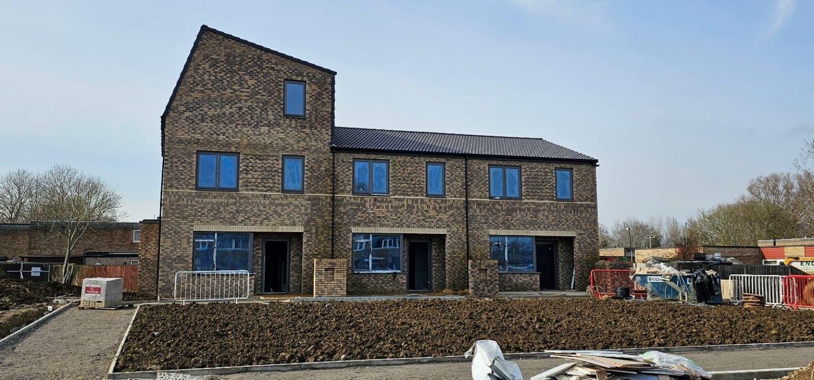
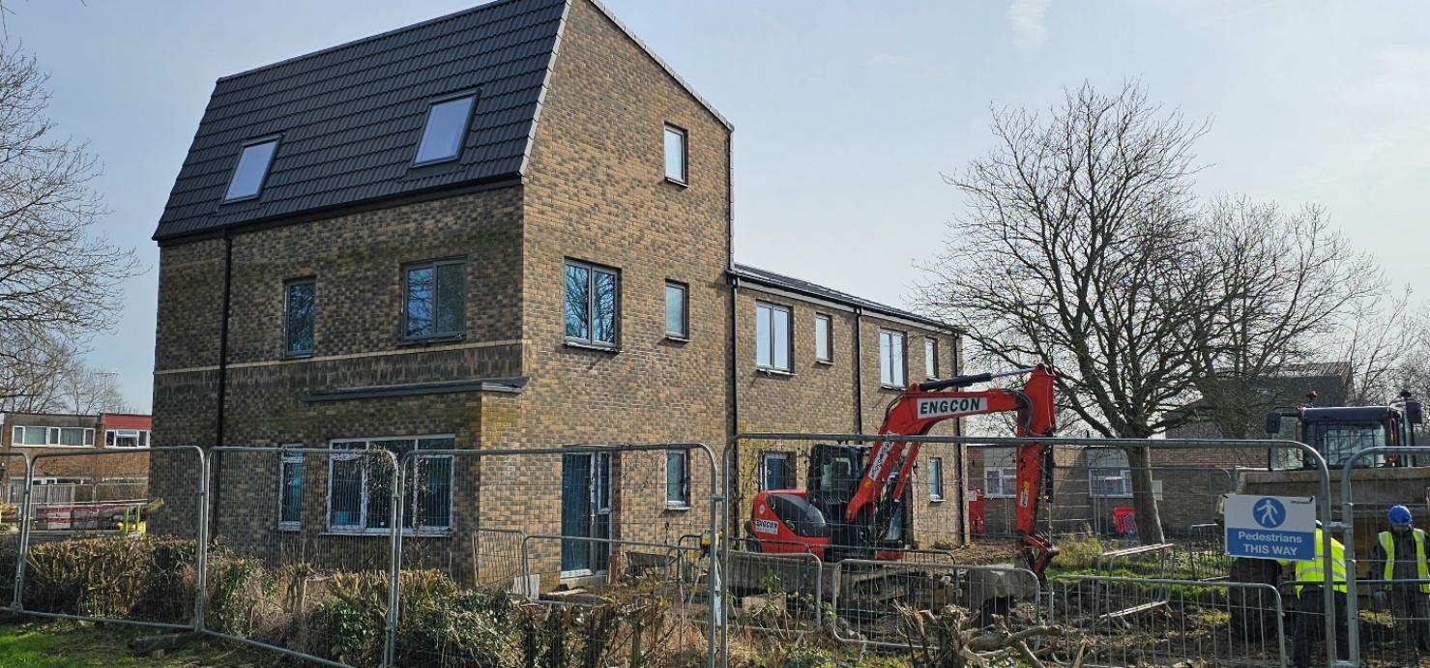
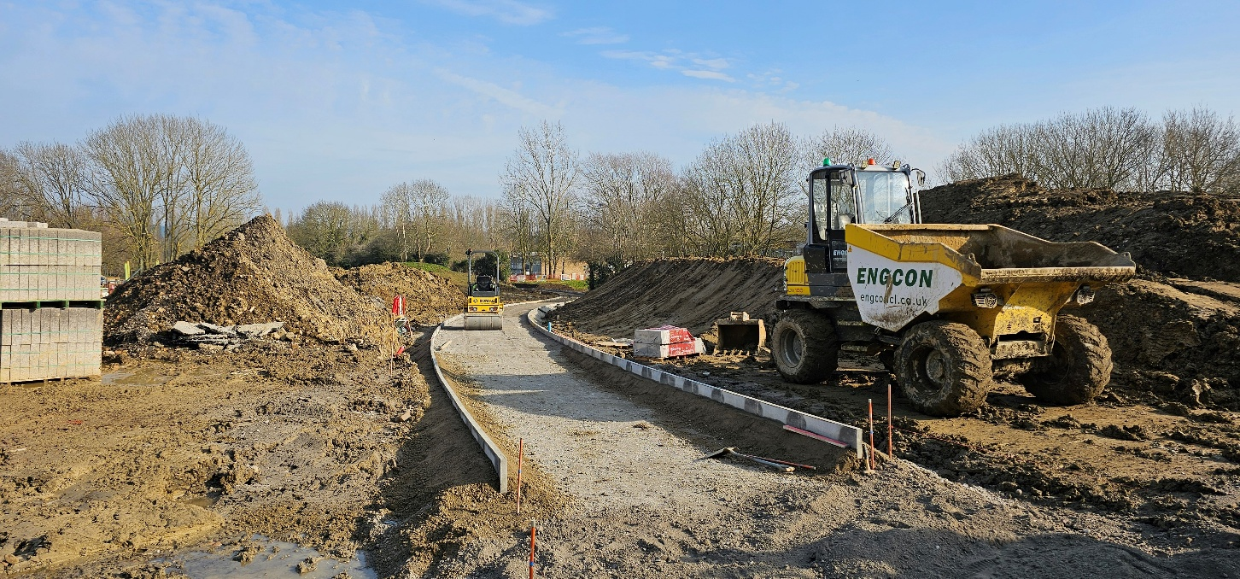
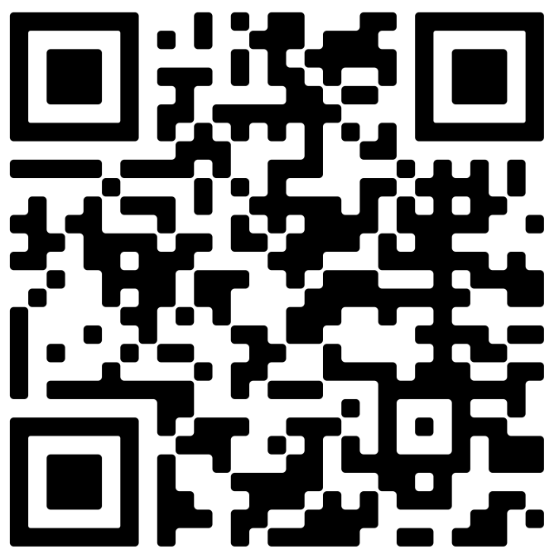

SITE BY SITE UPDATES AND PROGRAMME STATEMENT
SITE | UPDATE
Windermere Drive A1 | 11A & B masonry ongoing to internal and external walls.
Warren Park | Cut and fill ongoing. Further creation of new footpaths.
Windermere Drive A3 | 8A & B internals commenced and screeding complete.
Melfort Drive | All blocks at various stages; internal commencement, roofing ongoing, masonry ongoing or complete.
Burnmoor Close | Block 1 precast complete and masonry ongoing. Block 2 roof complete and internals ongoing.
Drayton Road | Attenuation tanks complete 1A-2A. Continuation of precast planks, masonry and roof work. Substation base install.
Windermere Drive A1 | Windermere A3 (Bramley Grange)
11A 1st, 2nd and 3rd floor masonry ongoing. 11B 1st and 2nd floor masonry continuing. Bellmouth to entrance progressing. Rear of 11A tarmacked. | 8A & B internals ongoing – currently installing partitions throughout all plots and closing up walls. Hard landscaping progressing in all areas of site.
Drayton Road | Melfort Drive
Blockwork and roofs complete on all houses. Masonry continuing to flats, and internals continuing site-wide. Garry Close car park reopened. | Masonry and roofs complete across the site. Internal fitout continuing across all blocks. External services progressing. Hard landscaping progressing.
Burnmoor Close | Warren Park
Block 1 and block 2 roofs complete and internals and hard landscaping continuing. | Water basin formed with footpaths ongoing from Stoke Road up towards Windermere A1 site.
POTENTIAL DISRUPTIVE ACTIVITIES
SITE | AREA | DETAILS
Windermere Drive A3 | Bramley Grange / GP Surgery | Footpath behind GP surgery, running parallel with Bramley Grange site, closed until mid-January.
Burnmoor Close | Burnmoor Close | Road closed with phased car park closures from 02/12/24 – 13/01/25 (reopening between Christmas 20/12/24 -06/01/25).
Drayton Road | Garry Close | Car park and surrounding footpath closed until mid-December.
​
CONTACT US​
Microsite QR Code
Resident Liaison Officer
Samantha Key – 07391 185430 (Out of hours if urgent - 02895 071 034)
buildingsouthcustomerrelations@graham.co.uk
Visit us at graham.co.uk
Site Office, GRAHAM, Windermere Drive, Bletchley, MK2 3NS

